Slide 1
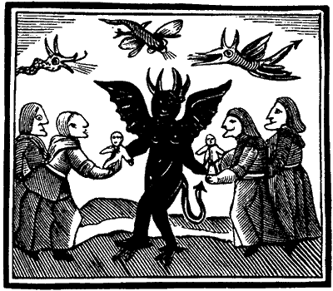
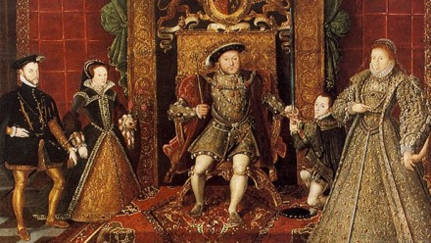
History A-level
Course information
Deeper Thinking Questions:
Why do you think the course looks interesting?
How can you prepare for the A-level effectively?

Slide 2
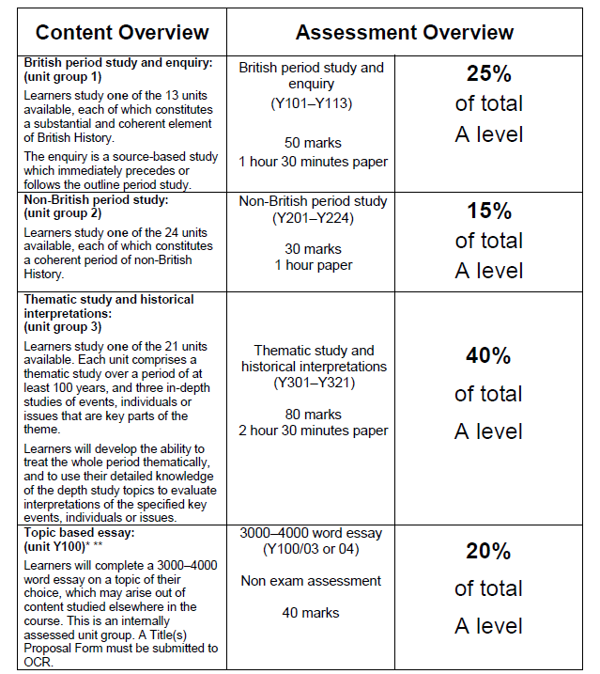
History A-Level Course details
OCR Level 3 Advanced GCE in History A (H505)
First Assessment 2017
England 1547–1603: the Later Tudors
(Enquiry topic: Mid Tudor Crises 1547–1558)
Russia 1894-1941
Popular Culture and the Witchcraze of the 16th and 17th Centuries
Russia 1894-1941

Slide 3
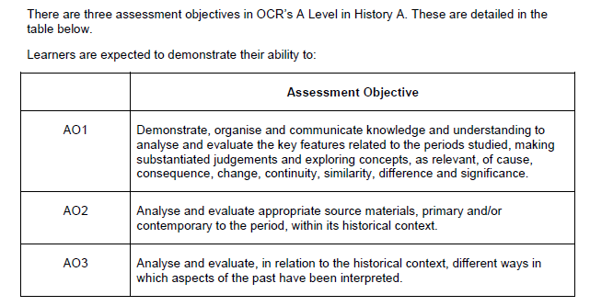
History A-Level Course details
Assessment Objectives (Aos)
Where can I find out more?
http://www.ocr.org.uk/qualifications/as-a-level-gce-history-a-h105-h505-from-2015/

Slide 4
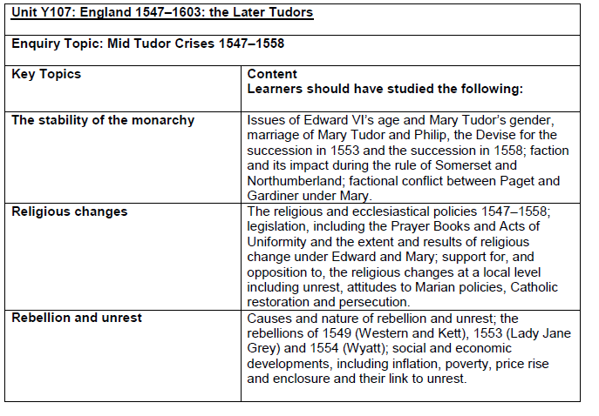
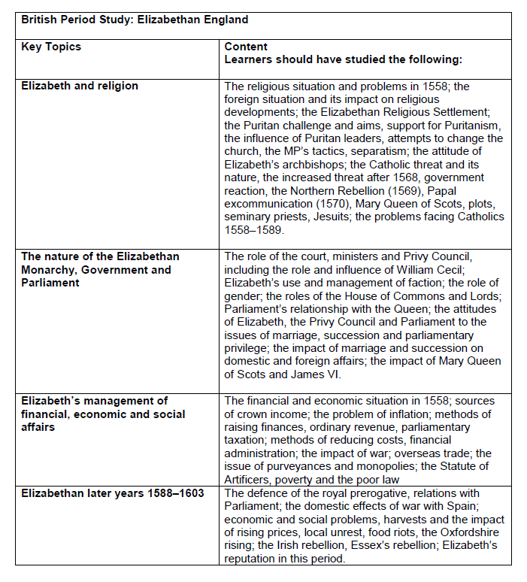

Slide 5
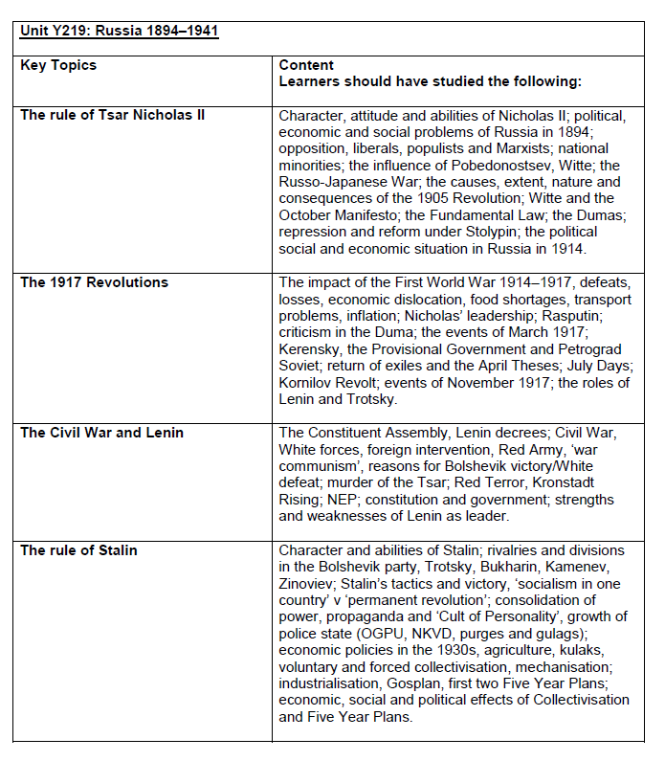

Slide 6
