Slide 1
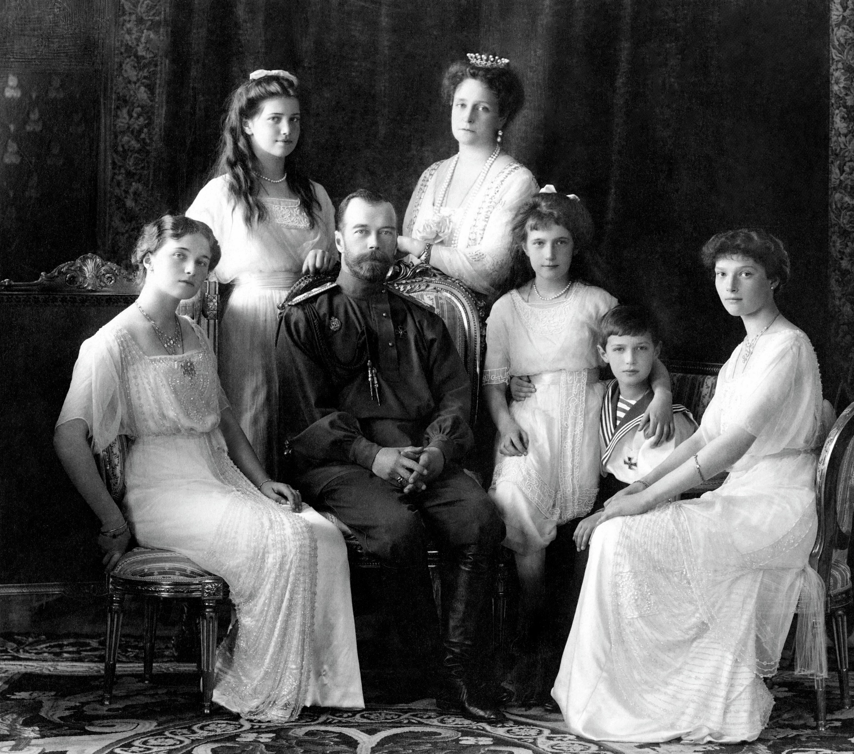
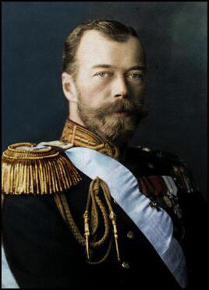
The Rule of Tsar Nicholas II

Slide 2
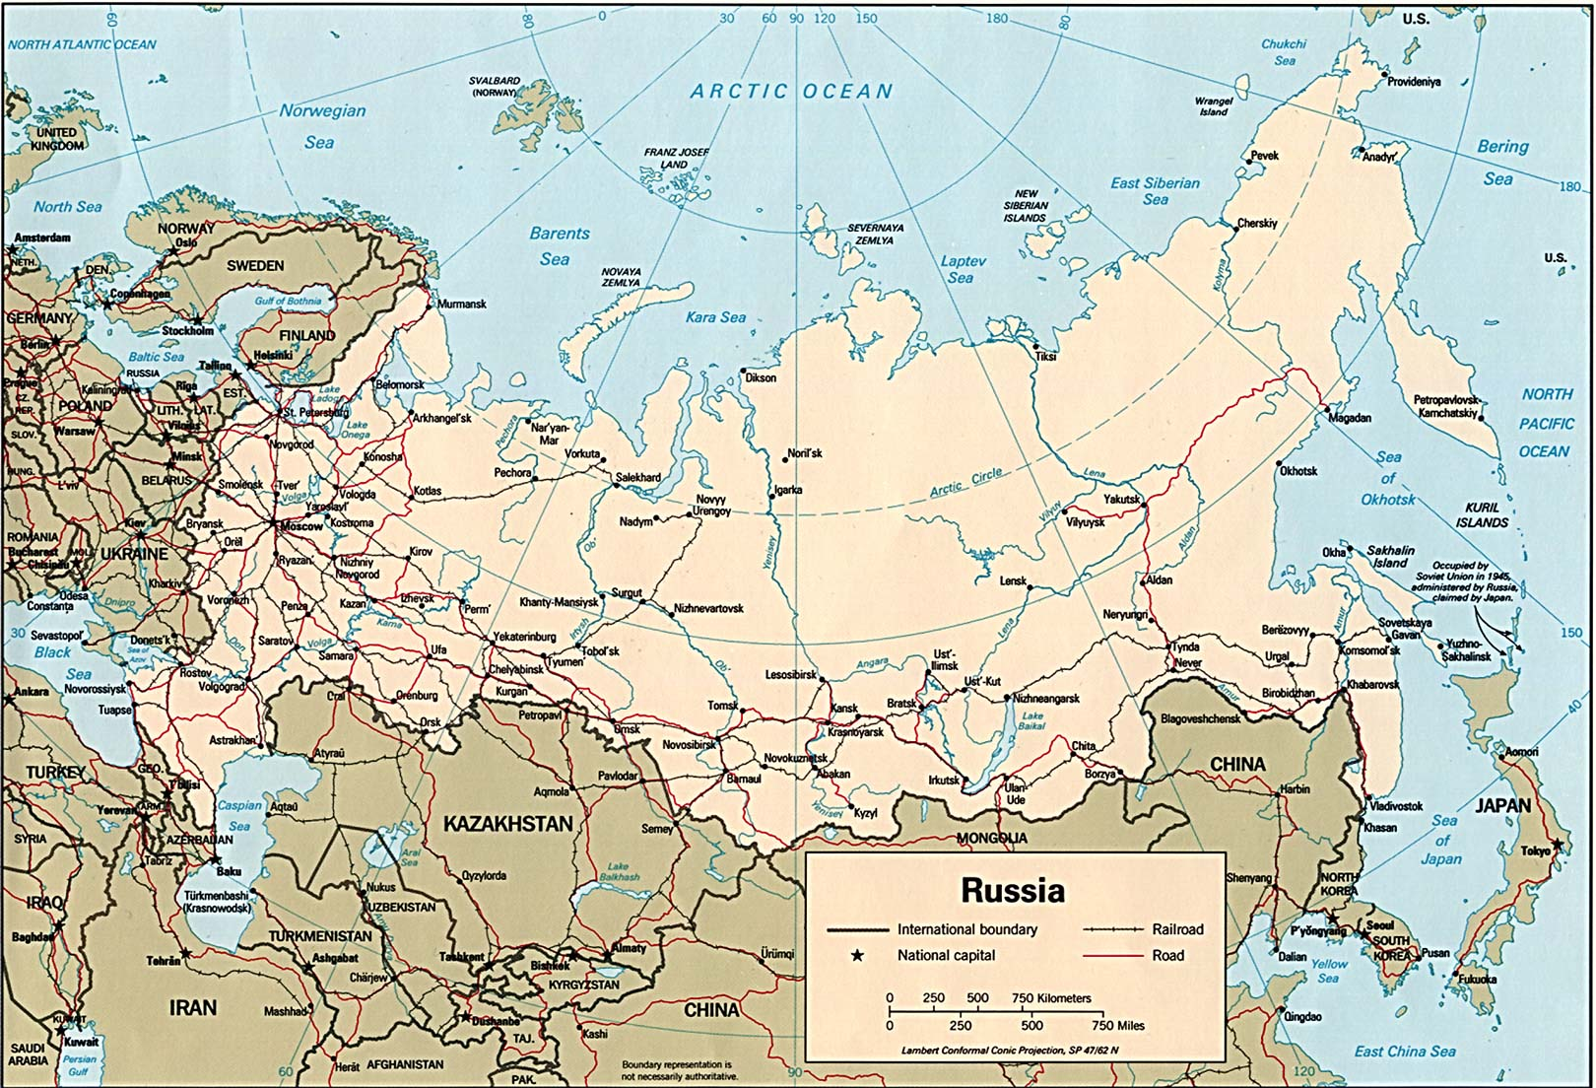
What was Russia like?
In 1894, Imperial Russia covered over 8 million square miles (22 million square kilometres), an area equivalent to two and a half times the size of the USA today.
It covered a large part of two continents , European Russia extended eastward from the borders of Poland to the Urals mountain range. Asiatic Russia extended eastward from the Urals to the Pacific Ocean.
The greater part of the population, which between 1815 and 1914 quadrupled from 40 million to 160 million ,was concentrated in European Russia.

Slide 3
What was Russia like?
European Russia was where the major historical developments occurred. This is where its principle cities, Moscow and St Petersburg (the capital) were.
The people of Russia had various nationalities such as Great Russian, Ukrainian, Polish, Yiddish (Jewish), German, Latvian, Lithuanian and many more.

Slide 4
The Tsar (Emperor)
The people of the Russian Empire were governed by one person: the Tsar (Emperor).
Since 1613, the Russian Tsars had been members of the Romanov dynasty (the Royal house that ruled Russia).
In 1832, Nicholas I issued the ‘Fundamental Laws of the Empire’. Article 1 said: ‘The Emperor of all the Russias is an autocratic and unlimited monarch. God himself ordains that all must bow to his supreme power, not only out of fear but also out of conscience.’

Slide 5
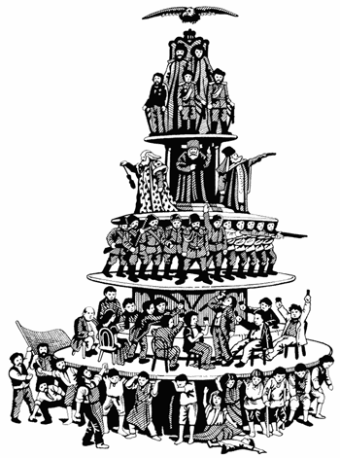
The Tsar (Emperor)
There were three official bodies through with the Tsar exercised his authority…
The Imperial Council: A group of honorary advisers directly responsible to the Tsar
The Cabinet of Ministers: They ran the various government departments.
The Senate: They supervised the operation of the law.

Slide 6
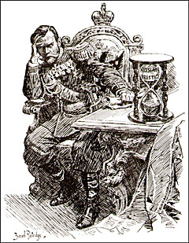
Russia’s political background
By the beginning of the twentieth century all the major Western European countries had some form of democratic or representative government.
There had been some reforming Tsars, however, their achievements had not included political rights. It was still a criminal offence to oppose the Tsar or his government.
There was no parliament and although political parties had been formed they had no legal right to exist.
There had never been a free press in Imperial Russia. Government censorship was imposed on published books and journals.

Slide 7
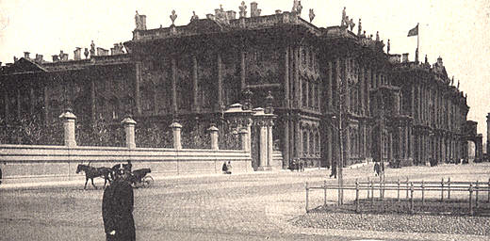
The Social Structure of Tsarist Russia
The class distribution of the Russian population in 1897…
Ruling class (Tsar, court and government) – 0.5%
Commercial class (merchants, factory owners, financiers) – 1.5%
Working class (factory workers and small traders) – 4%
Upper class (nobility, higher clergy, military officers) – 12%
Peasants (land dwellers and agricultural workers) – 82%

Slide 8
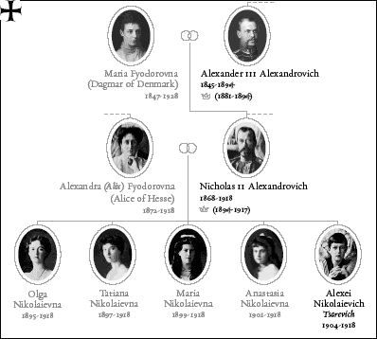
Tsar Nicholas II
He was born in 1868.
In 1894, he became Tsar and married Alexandra, the German grand-daughter of Queen Victoria.
Tsar Nicholas II often has an unfair reputation. He is seen as far from unintelligent but as having limited imagination. This prevented him from grasping the nature of the events in which he was involved.

Slide 9
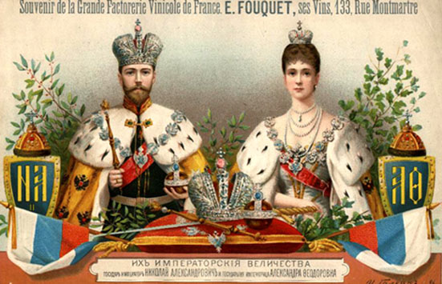
Tsar Nicholas II
Nicholas II and Alexandra had four daughters and one son.
Their children were named Olga, Tatiana, Maria, Anastasia and Alexei. The couple were overjoyed when Alexei was born, he was their only male heir. However, Alexei was diagnosed with haemophillia (a disease which means your blood does not clot if you hurt yourself) which meant his life was always in danger.
He loved his family and was truly devoted to them all.

Slide 10
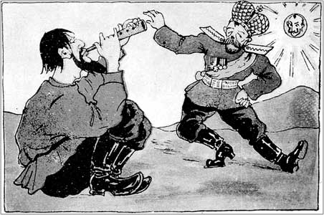
Tsar Nicholas II
The Royal couple were very protective of their son.
They had Rasputin, a monk, look after their son. He was known for his healing powers and the Royal couple trusted him. He was thought to have had magical powers that enabled him to cure the young heir to the throne.
Rasputin did not have magical powers but was a good amateur psychologist. He realised that the examinations Alexei was undergoing were making him anxious.
Rasputin is often credited with ending the Tsarist regime as his involvement with the family made people lose faith in the system. .

Slide 11
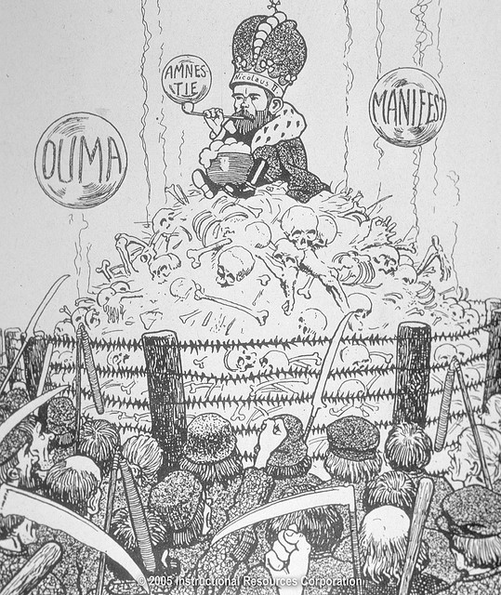
Views/Accounts of Tsar Nicholas II
Leon Trotsky said: ‘Nicholas inherited from his ancestors not only a giant empire, but also a revolution. And they did not bequeath him one quality which would have made him capable of governing an empire. Or even a country.’
Felix Yusupov said: ‘Russia was not prepared for war, and those who encouraged the Tsar in his purpose betrayed their Sovereign as well as their country. Russia’s enemies took advantage of the general dissatisfaction to set the Government and the masses against each other.’
Tsarina Alexandra: ‘Our souls are fighting for the right against the evil. You are proving yourself the Autocrat without which Russia cannot exist. God anointed you in your coronation and God, who is always near you, will save your country and throne your firmness.’

Slide 12
Views/Accounts of Tsar Nicholas II
General Peter Wrangel said: ‘Those of us who loved our country and the Army were terribly anxious at the continual changes in the Ministry, the conflicts between the Government and the Duma, the ever-increasing number of petitions and appeals addressed to the Tsar by many influential organizations, each one demanding popular control, and, above all, by the alarming rumours concerning certain persons in the Tsar’s entourage.’
Alexander Kerensky said: ‘The country now realizes that the Ministers are but fleeting shadows. The country can clearly see who sends them here. To prevent a catastrophe the Tsar himself must be removed, by force if there is no other way.’

