Slide 1
SOCIOLOGY A LEVEL Sociology is the study of people in their daily lives in places such as education, the workplace and family. Sociologists seek to understand how people think and behave and what factors affect their actions. Sociologists study a range of issues in society including family, social class, poverty, gender, media, religion and crime.
WHAT WILL I NEED TO BE SUCCESSFUL ON THIS COURSE?
A GCSE grade 4/5 or above in English, Maths and and in one Humanities subject.
WHAT WILL I DO?
Within Sociology you will cover knowledge of what is culture and socialisation, and how we gain our identity. In the first optional unit you will learn about families and relationships, studying diversity of family types in the UK and roles within households such as the changing role of men and women. You will look into different perspectives on the family using theoretical explanations. Inequality is a compulsory topic you will study, looking at different groups and their experiences of inequality and theoretical perspectives on this. Your second optional unit will look at crime and deviance, you will look at how crime is defined and measured, patterns and trends, and how crime can be reduced. Your course will also give you insight into how research is carried out by sociologists, taking part in a class practical to demonstrate your skills.
WHAT CAREERS WOULD THIS BE SUITABLE FOR?
.Sociology gives you an understanding of society, and is useful in many different areas. Sociology is useful to a career in the police force, counselling, health care, criminal justice system, teaching, social care, youth work, human resources, research, marketing, journalism, media, charity, government, housing, and probation work.
WHERE CAN I FIND OUT MORE?
Exam Board: OCR Course Title: Sociology Advanced Level QAN Code 601/3997/3 http://www.ocr.org.uk/Images/170212-specification-accredited-a-level-gce-sociology-h580.pdf

Slide 2
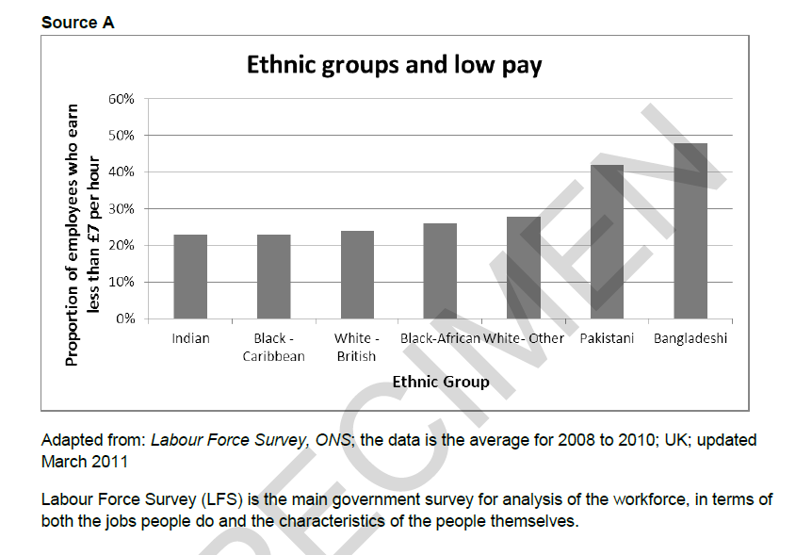
Sociology
Probation Tasks
Sociology in the news. Collect relevant news stories, articles and statistics that are relevant to Sociology. You could keep these in a scrapbook/word document/folder. Be prepared to discuss the articles you have found in lessons in September, explaining how each relate to Sociology and why they might be of interest.
Write a paragraph from your own research to explain each of the different sociological theoretical views:
Functionalism
Marxism
Neo-Marxism
Weberian
Feminism
New Right
Postmodernism
3)
With reference to Source A explain strengths and weaknesses of using official statistics to study inequalities between ethnic groups.
4) Choose one of the essay questions below. Your finished essay should be 1000-1200 words.
To what extent can crime and deviance be reduced by punishment?
Assess the view that the roles of men and women in the family have changed.
To what extent has digital social communication affected social relationships?

