Slide 1
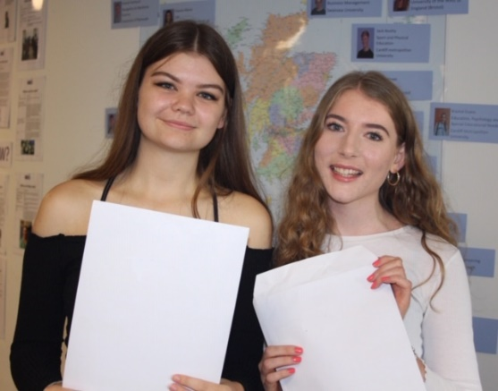
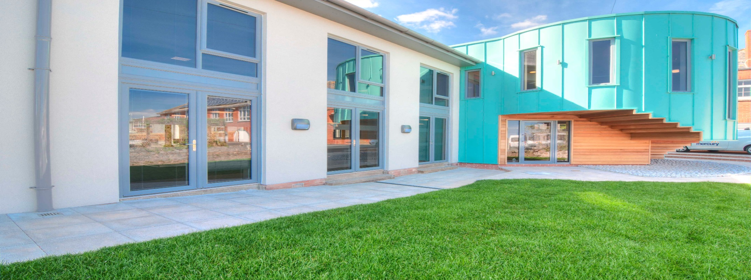
Welcome to Sixth Form
Parents Evening

Slide 2
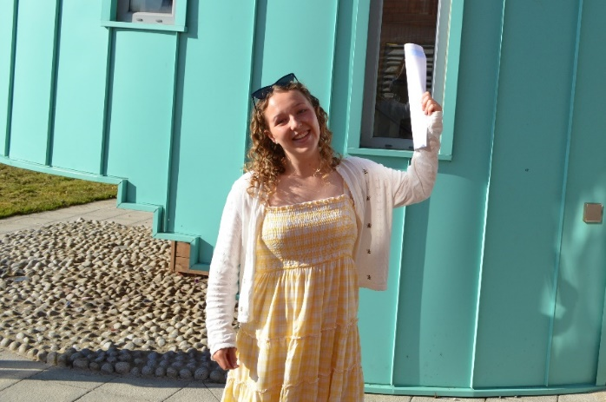
Aims of the Session
Sixth Form Life
Key routines
Assessment and monitoring
Looking to the future

Slide 3
Ensuring Success at TCS 6
Our Aims:
To enable students to do as well as they can, to get where they want to go.
To provide opportunities to enable our students to develop skills for the future: social and leadership as well as academic.
To foster confident, balanced and happy citizens through an enjoyable experience.

Slide 4
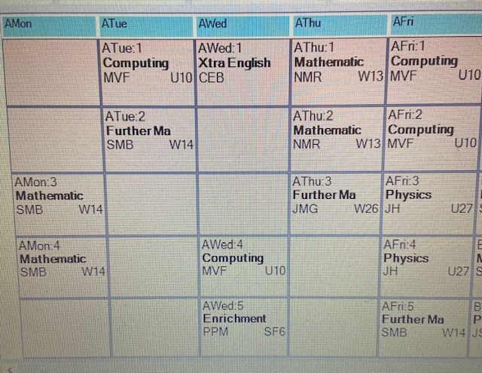
A Day in the Life of a Sixth Form Student
A student’s timetable is unique to their chosen subjects, and for Level 2 students lessons are combined with 1 day of work experience on a Thursday.

Slide 5
Attendance
Registration 8.50-9.10am on a Monday – Thursday
Level 2 students are not expected to register on their work experience day
If a student does not have any lessons on a certain day, they do not need to register.
Year 12 Form Tutors
Miss Edwards (JE) joanne.edwards@teignmouthschool.co.uk
Mr Johns (RHJ) richard.johns@teignmouth.devon.sch.uk
Mr Feeney (MVF) Michael.Feeney@teignmouthschol.co.uk
Sixth Form Team
laura.Milsom@teignmouthschool.co.uk – Head of Sixth Form
melanie.deeks@teignmouthschool.co.uk – Deputy Head of Sixth Form
tammie.best@teignmouthschool.co.uk - Attendance and study centre
kamel.Benchouiha@teignmouthschool.co.uk – Progress Leader

Slide 6
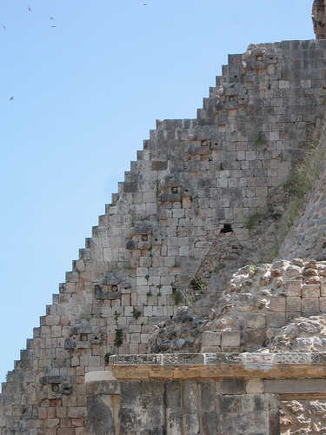
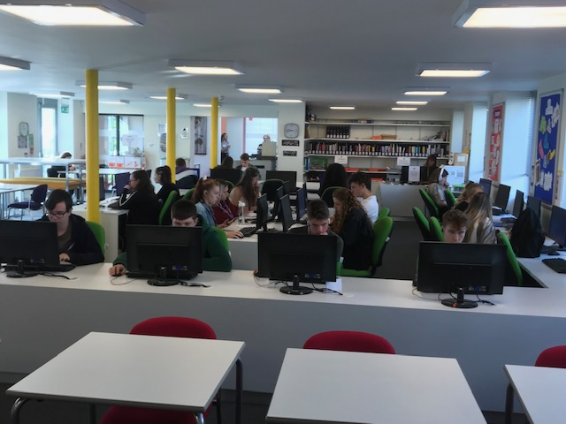
Study Periods
Sixth Form students are allocated 6+ study periods a week. (Extra study if they are resitting Maths/English).
These lessons should be used constructively for independent study, this is an essential skill that students need to master in order to be completely successful in their studies.
Next Steps
LEVEL 3
LEVEL 2 + Resit/s
GCSE

Slide 7
Reporting Absence
Student Timetables
Attendance Policy and Reporting Absence
Absence must be reported on the first day of absence before 9am if at all possible. You should report this by phoning 01626 774091 and selecting number 2 for Sixth Form attendance.
All doctors, dentists and hospital appointments should be taken outside of school hours. However, if this is not possible, an Absence Request Form must be completed.
If students are taken ill at School they must sign out with Mrs Deeks/Mrs Best so that absence from lessons is recorded.
An absence request form must be completed if students have to miss school but this is to be avoided at all costs and will only be an authorised absence in exceptional circumstances.
Every student has a unique timetable based on their chosen subjects.
Level 3 students will have on average 5 lessons per subject
Level 2 students, have on average 10 lessons for their chosen course, with work experience, resit lessons of Maths/English.

Slide 8
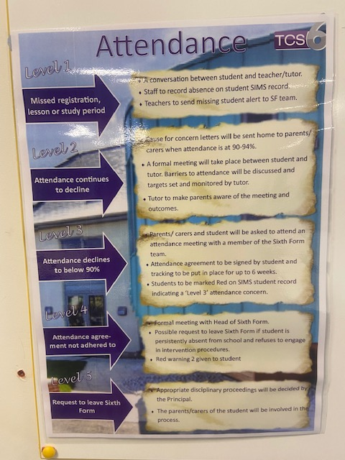
Attendance Policy
Level 2 – Concern letter sent home when attendance drops to 94-90%. Tutor will meet with student.
Level 3 - Parent/Student meeting with Sixth Form Staff if attendance falls below 90%. Attendance monitoring and support to be put in place. (Warning 1)
Level 4 – Formal meeting with Head of Sixth Form with a possible request to leave the Sixth Form (Warning 2)
Level 5 – Request to leave SF

Slide 9
TCS6 Dress Code
At TCS6 our code is ‘smart casual’. Students are expected to dress at all times in a manner that is fitting for a maturing young person in a professional environment. We realise that one of the attractions of being a sixth former is the privilege of wearing your own clothes rather than a uniform; we therefore do not specify what is permissible within the parameters of ‘smart casual’.
However, the following items are not acceptable:
Dirty or ripped clothing;
Offensive slogans;
Revealing tops, shorts or skirts
Bare midriffs;
Ostentatious jewellery
Hoods, caps and hats on school site, unless for medical reasons.
Sixth form students must wear their security badge, which is issued from the school, at all times when on school premises. This is to support the safeguarding of all students.

Slide 10
Probation
Student Timetables
Every student has a unique timetable based on their chosen subjects.
Level 3 students will have on average 5 lessons per subject
Level 2 students, have on average 10 lessons for their chosen course, with work experience, resit lessons of Maths/English.
Students are currently in the Probation period.
Probation ensures that students are on the correct courses in terms of ensuring their success.
Opportunity to move, and pick up additional courses in some cases such as EPQ.
Sixth Form Leaders follow up meetings ensure support is offered to all our students.
Probation assessments - Week Beginning 27th September
Sixth Form Leaders follow up meetings 4-7th October

Slide 11
Rewards
Student Timetables
Every student has a unique timetable based on their chosen subjects.
Level 3 students will have on average 5 lessons per subject
Level 2 students, have on average 10 lessons for their chosen course, with work experience, resit lessons of Maths/English.
Postcards home and display at the SFC
Half termly Amazon voucher draw
Trips!

Slide 12
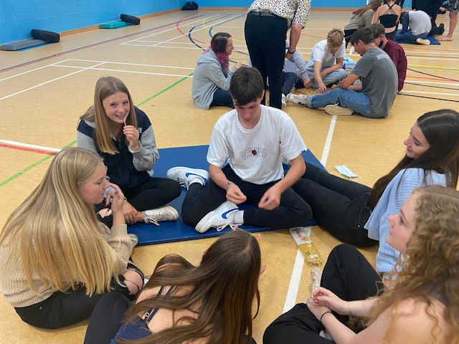
Enrichment
At TCS6, learning extends far beyond the classroom. The skills learnt in our Enrichment Programme will support studies and well-being, as well as helping our young people to prepare for life after school.

Slide 13
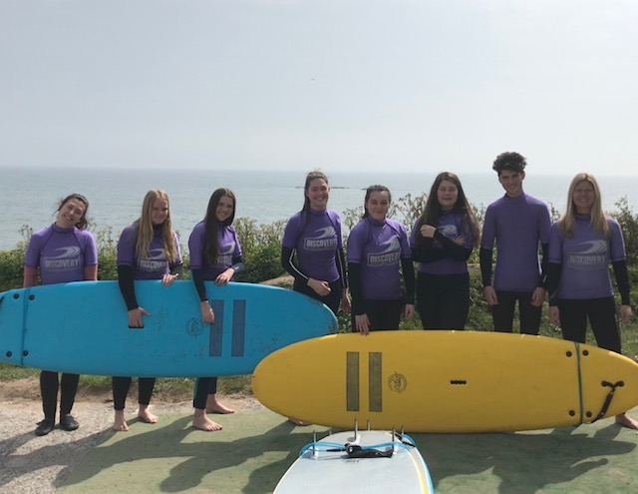
Student Timetables
Enrichment
Volunteering
Student Ambassador programme
Leadership
Study Skills
Get Active
Work Experience
Duke of Edinburgh, Ten Tors
When?
Wednesday P5
Where?
On and off site
Every student has a unique timetable based on their chosen subjects.
Level 3 students will have on average 5 lessons per subject
Level 2 students, have on average 10 lessons for their chosen course, with work experience, resit lessons of Maths/English.

Slide 14
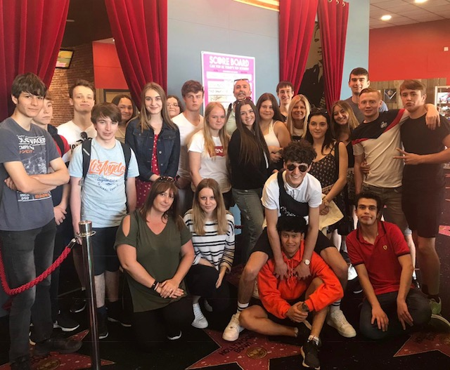
Supporting Next Steps
Throughout the year TCS6 supports students in reaching and achieving their ambitions:
Enrichment days – Sixth Form Specific
Northumbria University – Student Life presentation
Bath University - Study Skills & Personal Statements
Trips
Master classes facilitated by NSSW – Subject specific
University Taster days – Plymouth, Exeter, London, Cardiff
Social opportunities – a termly trip for students to organise

Slide 15
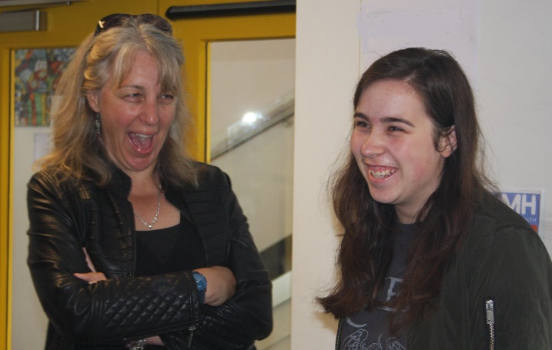
Monitoring and Tracking
Progress
Assessments
Probation Assessments | 23-27th September
SF Assessment week | 13th December
Communication with home
Sixth Form Subject parents evening | Wednesday 20th October
Sixth Form Parents: Coffee and Chat | Friday 10th December 9.30-12.30pm
Sixth Form Website/Instagram | Ongoing – updated regularly
Sixth Form News Round Up | Termly newsletter
Reporting Progress (via email)
Written Report | Jan 2022
Data Report | March 2022
Data Report | July 2022

Slide 16
16-19 Bursary
What a bursary is for?
The 16-19 bursary is a limited fund made available for supporting eligible young people with the costs of transport, food, books, educational visits or other course materials or equipment essential to successfully completing their programme of study.
There is assistance available to support students at TCS6; application forms and more details are available from Mrs Deeks.

Slide 17
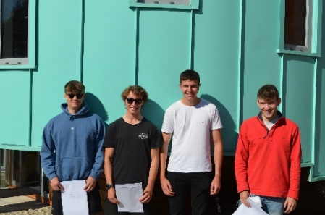
Exam Success 2021
All students applying to University have been awarded a place
100% pass rate for level 3 courses
44% of Level 3 grades were A/A* equivalent
Back | Yasmin | University of Plymouth | Nursing (Adult Health)
Cannonier | Esme Joy | Birmingham City University | Marketing
Cartwright | Emily Jane | Cardiff University | Neuroscience
De Lange | Lucy | Bristol, University of the West of England | Forensic Science (with Foundation Year)
Dunne | Archie | University of Kent | Biomedical Science with a Sandwich Year
Hudson | Dylan | Bristol, University of the West of England | Physiotherapy
Hughes | Alicia | University of Exeter | Modern Languages
Jones | Nathan | Cardiff Metropolitan University | Product Design
Lockyer | Millie | University of Bristol | History
Martin | Eve | University of Portsmouth | Criminology and Forensic Studies
McGeary | Rhys Billy | Loughborough University | Aeronautical Engineering
McNally | Maximillian Louis | University of Portsmouth | Economics
Michaud | Molly | Cardiff University | Human Geography
Overson | Phoebe | Keele University | Physiotherapy with Integrated Masters
Rodwell | Joseph James | University of Exeter | Civil Engineering
Scollick | Finlay James | University of East Anglia UEA | Geography and International Development with a Year Abroad
Tapp | Amelia Kate | London School of Economics and Political Science | Economics
Turner | Ben | Liverpool John Moores University | Civil Engineering
Van Hagen | Charlie | University of Cumbria | Sport Rehabilitation

