Slide 1
BTEC National Health and Social Care
Taster Session

Slide 2
1 A Level - Course Details & Structure
Year 12 BTEC National Certificate (1 AS Level) (180 GLH) |  | Year 13 BTEC Extended Certificate (1 A Level) (360 GLH)
Unit Details | Assessment Details | Unit Details | Assessment Details
Unit 1 Human Lifespan Development | External 1hr 30min Exam 90 marks (Pass, Merit, Distinction) | Unit 2 Working in Health and Social Care | External 1hr 30min Exam 80 marks (Pass, Merit, Distinction)
Unit 5 Meeting Individual Care and Support Needs | Internal Assignment Based Coursework (Pass, Merit, Distinction) | Unit 14 Physiological Disorders and their Care | Internal Assignment Based Coursework (Pass, Merit, Distinction)

Slide 3
The Pearson BTEC Level 3 Health and Social Care qualifications aim to provide an overview of the sector. It is for you who are interested in learning about the health and social care sector as part of a balanced study programme. It is equivalent in size to an A-Level (1 year programme) It will enable you to progress to a degree programme chosen from a range of programmes in the health and social care sector. The qualification is intended to carry UCAS points and is recognised by higher education institutions as contributing to meeting admission requirements to many relevant courses.
About the Qualification

Slide 4
Grading & BTEC Points
Calculating the Overall Grade
INTERNAL UNITS
EXTERNAL UNITS

Slide 5
Midwifery Primary School Teacher Nutritional Therapist Nursery Nurse Counsellor Occupational Therapist Children’s Nurse Adult Nurse Social Worker Carer Dietician Educational Psychologist
Future Careers

Slide 6
Post 16 Taster Session Activity
Unit 1 (Sample Session)

Slide 7
Prepare Minds (Starter)

Slide 8
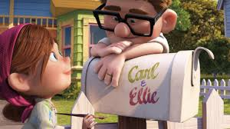
Activity 1
List the main life stages that you saw in the clip;

Slide 9
Birth – Infancy 0 - 2 years Childhood 3 - 8 years Adolescence 9 -18 years Early Adulthood 19 - 45 years Middle Adulthood 46 - 65 years Later Adulthood 65 + years
Life Stages

Slide 10
Activity 2
Identify the life events that you observed within the clip. Categorise these into predictable or unpredictable events.

Slide 11
Life Events
EXPECTED
UNEXPECTED
Starting School
Leaving School
Birth Of A Sibling
Moving House
Development Of Close Relationships
Employment
Living With A Partner
Marriage
Parenthood
Retirement
Ageing
Death Of A Partner, Relative Or Friend
Accident/Serious Injury
Ill Health
Exclusion/Dropping Out Of Education
Redundancy
Promotion
Imprisonment
Divorce
Abuse
Mental Health Difficulties
Bullying
Development through the life stages is categorised as PIES
Physical
Intellectual
Emotional
Social

Slide 12
Activity 3
In pairs
Draw a line on a piece of A3 paper half way down the page
At one end, put the word Birth.
At the other end, write the word Death.
Above the line write unexpected life events.
Below the line write expected life events.
Write on the time line words to describe these events.

Slide 13
Activity 3 Example

Slide 14
Look at the other time lines produced. Have they included any events that you have missed? Are there many similarities or differences in your time lines? Do any of their events surprise you?
Peer Assessment

Slide 15
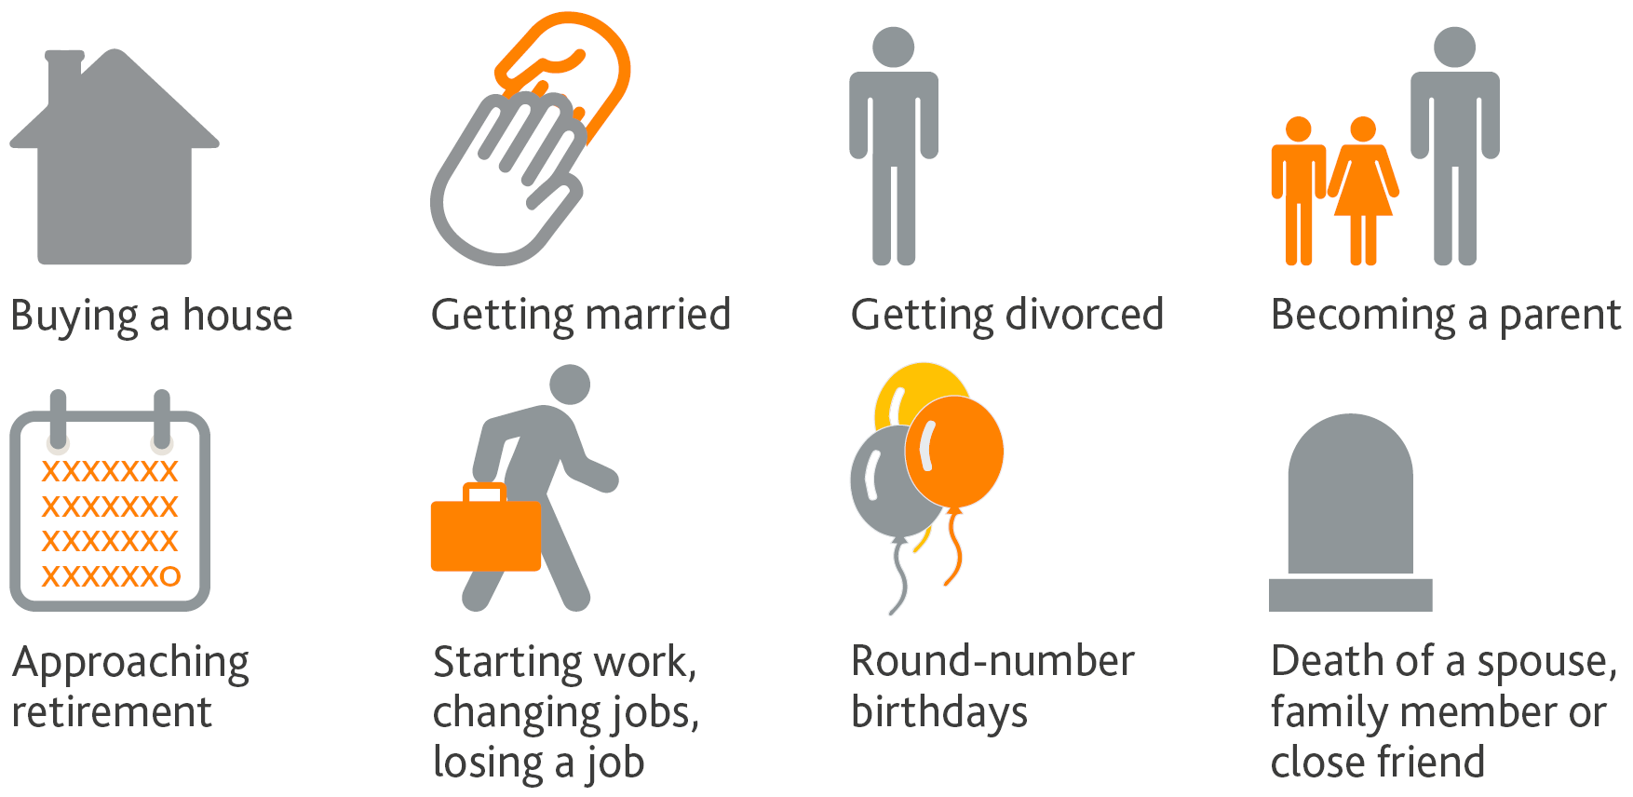
Activity 4
Choose one life event from your time line.
Write a short description of the life event and how it affects all types of development (link to PIES).
You will be asked to feed back to the group on this.

Slide 16
Rating Task
Look at your life events
Choose 10 of these and then rank them 1-10
in accordance as to how stressful you think each are.
1 = Least Stressful
10 = Most Stressful

Slide 17
Rating Task

Slide 18
Questions
Do you have any questions?

Slide 19
Activity 5
Using the activities you have already completed on life events, you know need to consider the effects of the events on an individuals health and well-being.
Using the template of the human body identify the different impacts.

