Slide 1
Chemigrams
Alternative Photography
A Level Photography Taster Task

Slide 2
“With the advent of photography in 1839, painting underwent a radical transformation. Nowadays, the digital process is revolutionising photography. The Chemigram, fusion of painting and photography, is most likely the ultimate adventure of gelatin silver bromide.” Pierre Cordier
Chemigrams are an adventure and one which students should embark upon to develop their understanding of darkroom materials and practices, but most importantly, to re engage with their childish sense of play, creativity and imagination. The single biggest problem we encounter as a Photography teacher at A-Level, is that students arrive from the GCSE model of learning, read the text book, know the fact, write it on the exam paper, get the grade. This is no way to teach, and no way to learn.

Slide 3
A Chemigram is a means of creating an image on light sensitive paper, without the need of a camera.
In real terms: take photographic paper, put stuff on it, see what happens.
Photographic paper is sensitive to light, exposing the paper to light and then placing in chemical developer causes a chemical reaction to occur in which the exposed areas become darker. Placing the paper in stop and then fix causes different reactions to occur which strip the light sensitive salts from the paper and then the paper is no longer sensitive to light. Our intention with Chemigrams is to play with these chemical reactions. Different liquids and materials act as a resist to the developing process and will affect how quickly the chemicals react to the paper.

Slide 4
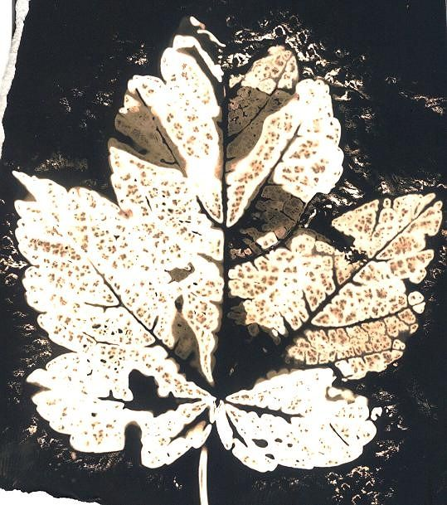
Chemigrams are created by forcing a chemical reaction between photographic paper and photographic chemistry
Negative
Positive
Dip items such as flowers, leaves etc into either developer or fix first.
Place the items on to a sheet of photographic paper.
Paint on developer or fix in addition if desired.
Once the chemicals have started to react with the paper, remove the items from the paper
Place the paper in to the tray of the fix or developer (opposite chemical you have used).
Place the paper coated with the resist in either the developer to get a black background, or the fixer to get a white background.

Slide 5
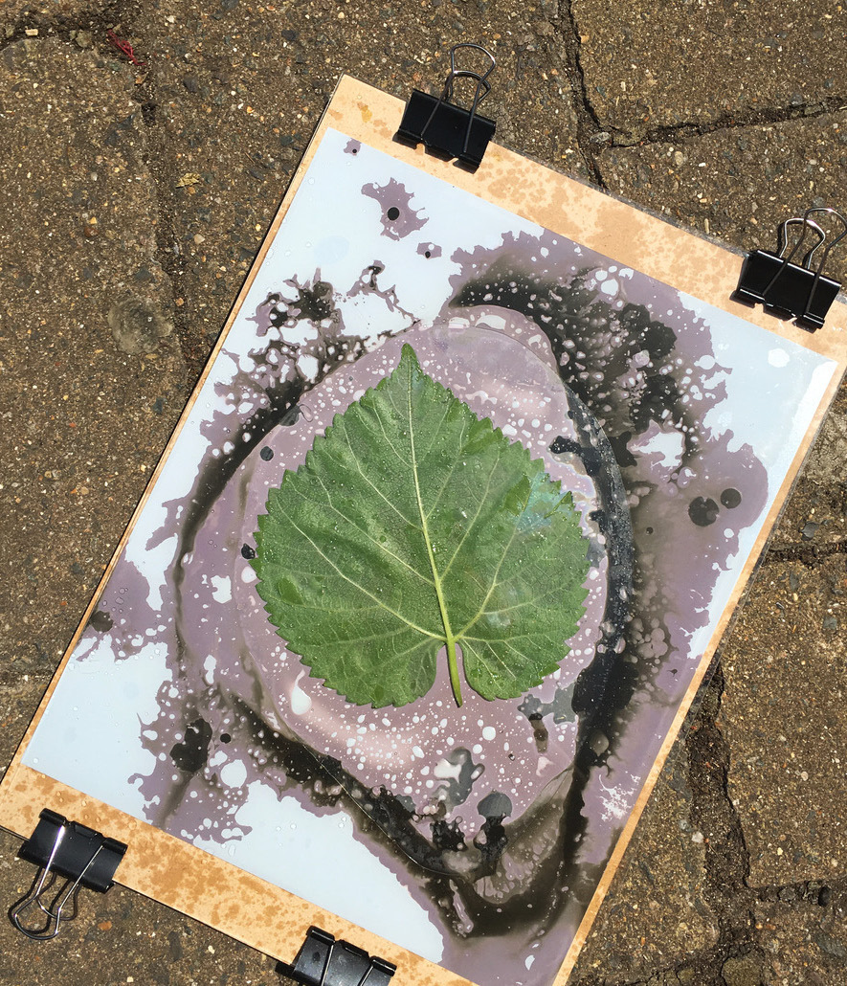
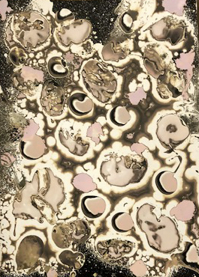
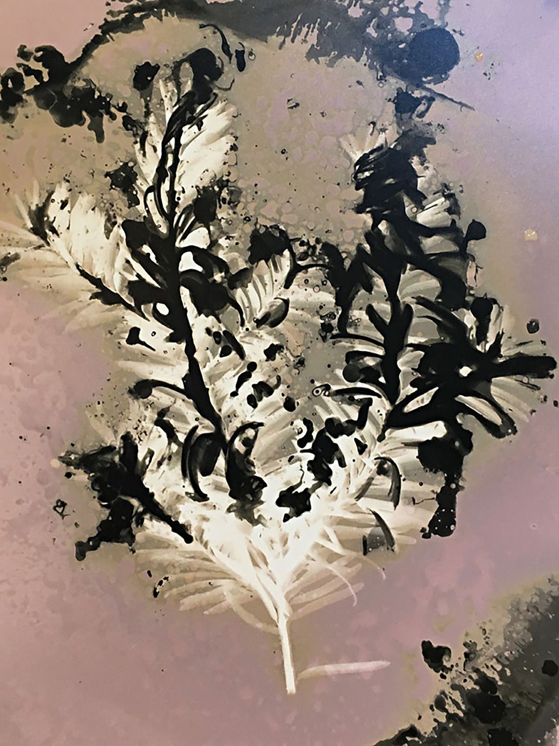
Experimentation
After you have practiced making a positive and negative chemigram you can experiment with different resists.
Resists are used to stop the development between the paper and the chemical reaction
RESISTS:
Vegetable Oil
Olive Oil
Vaseline
Nail Polish
Syrup

Slide 6
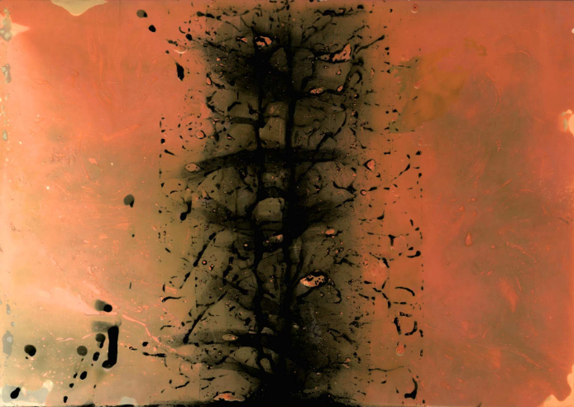
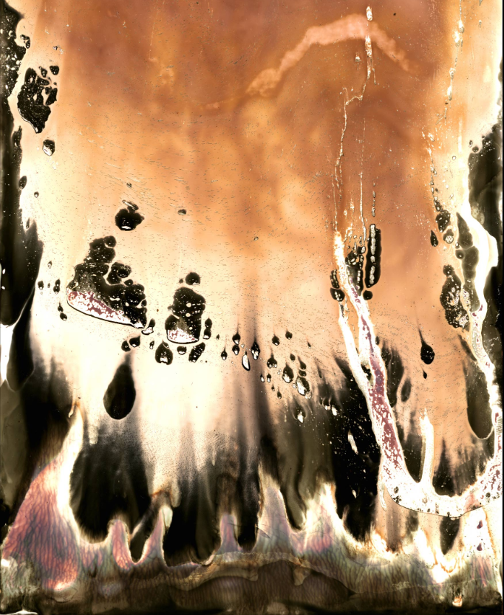
HOW TO MAKE AN ABSTRACT CHEMIGRAM?
Cordier discovered in 1956 was that a resist can hold back the chemical effects of developer and fixer on black and white photo paper for a time. Paper put into developer that has been exposed to normal room light for varying periods of time will turn black, except where a resist blocks the chemical reaction. The parts of the paper protected by the resist will continue to change colour from extended exposure to room light.
Bend the paper into a U shape so the developer can only touch the middle of the paper increases control over the liquid and produces interesting results.
Submerged one third of paper into stop, turned upside down so chemical runs down paper.
Submerged two thirds in developer.
Submerged whole thing in fixer.
Under red lights, take a few pieces of darkroom paper. Close up the box – the rest of the process takes place with the lights on
Choose a resist
Apply resist to photographic paper
Put photographic paper into chemicals in any order

Slide 7
Equipment:
Tray of Developer
Tray of Stop
Tray of Fix
Tray of Water
Gloves
Tongs
Photographic Paper
Resists: oils, Vaseline, nail polish, honey, butter
Paint brushes

