Slide 1
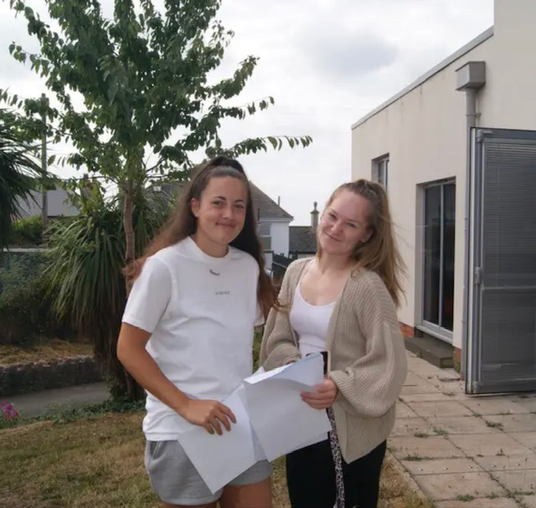
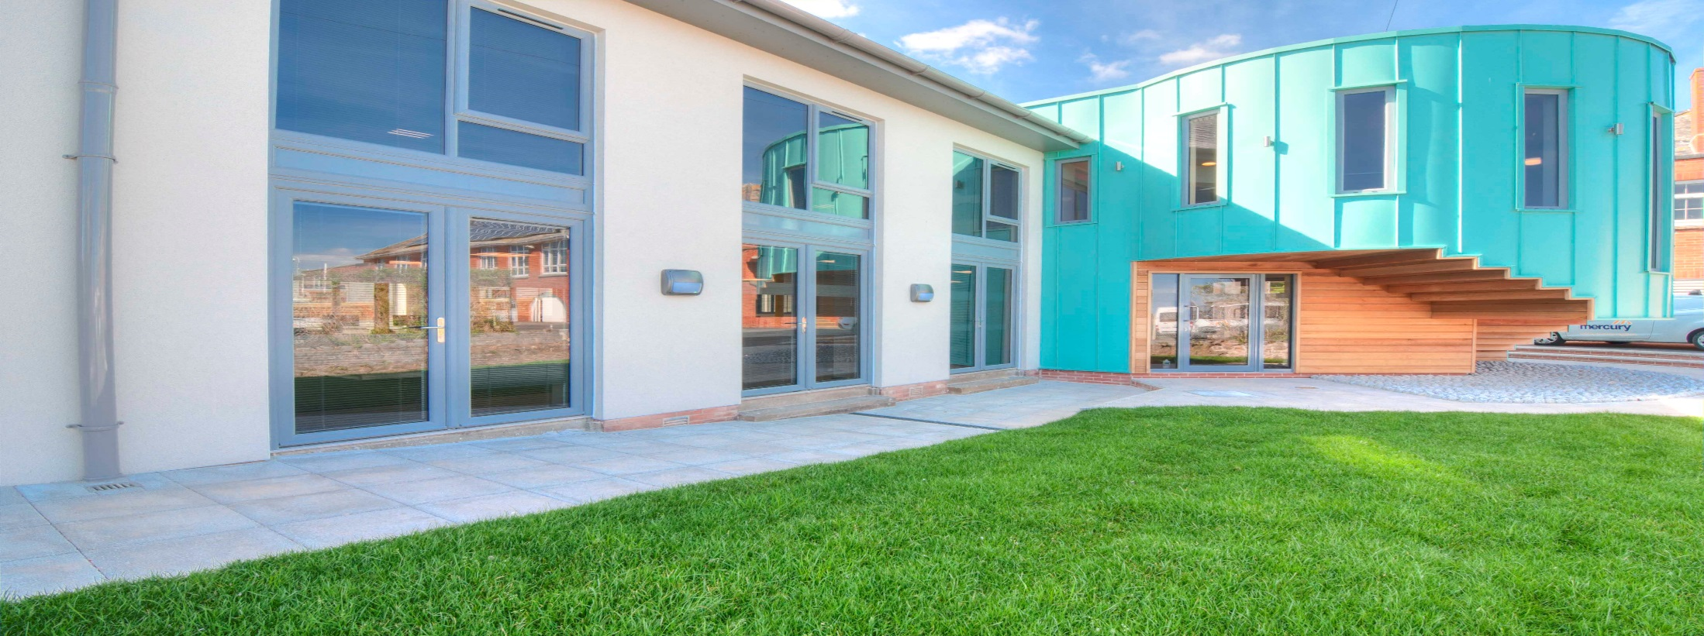
Sixth Form Parents Evening
2022-23

Slide 2
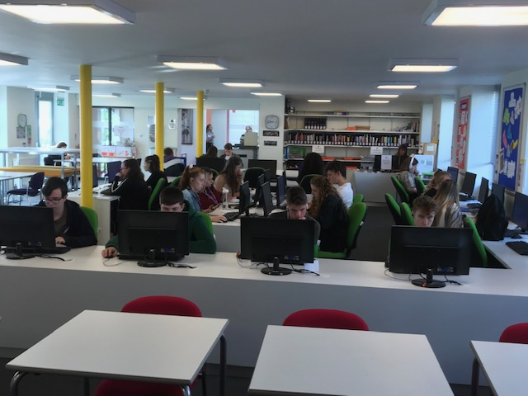
Study Periods
Sixth Form level 3 students are allocated 6 study periods a week (2 are flexible and can be done in a location to suit our students)
Level 2 students have 1 study period a week per resit subject they are taking
These lessons should be used constructively for independent study, this is an essential skill that students need to master in order to be completely successful in their studies.
Next Steps
LEVEL 3
LEVEL 2 + Resit/s
GCSE

Slide 3
Attendance
Registration 8.50-9.10am on a Monday – Thursday
Level 2 students are not expected to register on their work experience day
If a student does not have any lessons on a certain day, they do not need to register. (V rare!)
Year 12 Form Tutors
Mr Feeney (MVF) michael.feeney@teignmouthschool.co.uk
Ms Moloney (KPM) Kelly.moloney@teignmouthschool.co.uk
Mrs Gibbs (BVG) becky.gibbs@teignmouthschool.co.uk
Ms Bartlett (AHB) abby.bartlett@teignmouthschool.co.uk
Mrs Dart (SLD) sarah.dart@teignmouthschool.co.uk
Mrs Gibbs (BVG) becky.gibbs@teignmouthschool.co.uk
Mrs Best (Sixth Form attendance) tammie.best@teignmouthschool.co.uk

Slide 4
Reporting Absence
Student Timetables
Attendance Policy and Reporting Absence
Absence must be reported on the first day of absence before 9am if at all possible. You should report this by phoning 01626 774091 and selecting number 2 for Sixth Form attendance.
All doctors, dentists and hospital appointments should be taken outside of school hours. However, if this is not possible, an Absence Request Form must be completed.
If students are taken ill at school they must sign out with Mrs Deeks/Mrs Best so that absence from lessons is recorded.
An absence request form must be completed if students have to miss school but this is to be avoided at all costs and will only be an authorised absence in exceptional circumstances.
Every student has a unique timetable based on their chosen subjects.
Level 3 students will have on average 5 lessons per subject
Level 2 students, have on average 10 lessons for their chosen course, with work experience, resit lessons of Maths/English.

Slide 5
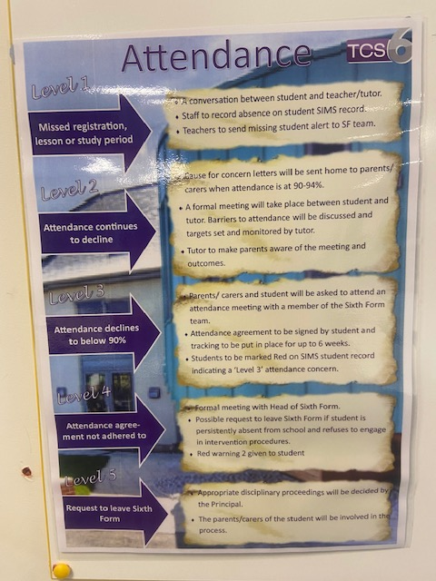
Attendance Policy
Level 1 – Tutors and SF team will be talking to the student and absence recorded internally.
Level 2 – Concern letter sent home when attendance drops to 94-90%. Tutor will meet with student.
Level 3 – Parent and student meeting with Sixth Form Staff attendance falls below 90%. Attendance monitoring and support to be put in place. (Warning 1)
Level 4 – Formal meeting with Head of Sixth Form with a possible request to leave the Sixth Form (Warning 2)
Level 5 – Meeting with Headteacher to determine future in the SF.

Slide 6
TCS6 Dress Code
At TCS6 our code is ‘smart casual’. Students are expected to dress at all times in a manner that is fitting for a maturing young person in a professional environment. We realise that one of the attractions of being a sixth former is the privilege of wearing your own clothes rather than a uniform; we therefore do not specify what is permissible within the parameters of ‘smart casual’.
However, the following items are not acceptable:
Dirty or ripped clothing;
Offensive slogans;
Revealing tops, shorts or skirts
Bare midriffs
Ostentatious jewellery
Hoods up around school site and in lessons
Sixth form students must wear their security badge, which is issued from the school, at all times when on school premises. This is to support the safeguarding of all students.

Slide 7
Probation
Student Timetables
Every student has a unique timetable based on their chosen subjects.
Level 3 students will have on average 5 lessons per subject
Level 2 students, have on average 10 lessons for their chosen course, with work experience, resit lessons of Maths/English.
Probation period
Probation ensures that students are on the correct courses in terms of ensuring their success.
Opportunity to move, and pick up additional courses in some cases such as EPQ and Core Maths
Sixth Form Leaders follow up meetings ensure support is offered to all our students.
Teachers will report Pass / Fail / Concern
Probation outcome - Week Beginning 3rd October
Sixth Form Leaders follow up meetings

Slide 8
Cover Lessons
Teachers will email the work to, ‘SF cover’
Please head to the SFC and Mrs Best will be able to give you the work set and any resources that have been passed on by your teacher.
Please then complete cover work at the SFC and email any work to your teachers, adhering to deadlines set

Slide 9
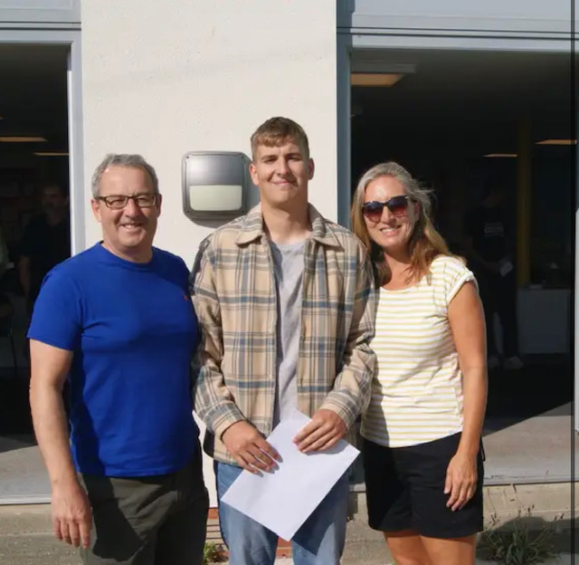
Monitoring and Tracking Progress
Assessments
Probation Assessments | Throughout September (3rd October outcome)
SF Assessment week 1 | 5-9th December
SF Assessment week 2 | 13-17th March
Walking talking Mock Exams | 20th-24th Feb
SF Assessment week 3 | 26-30th June
Additional communication with home
Sixth Form Subject parents evening | 16th November
Meet the tutor event | 6th October
SEND review | 30th Jan
Reporting Progress (via email)
Written Report | Jan 2022
Data Report | March 2023
Data Report | July 2023

Slide 10
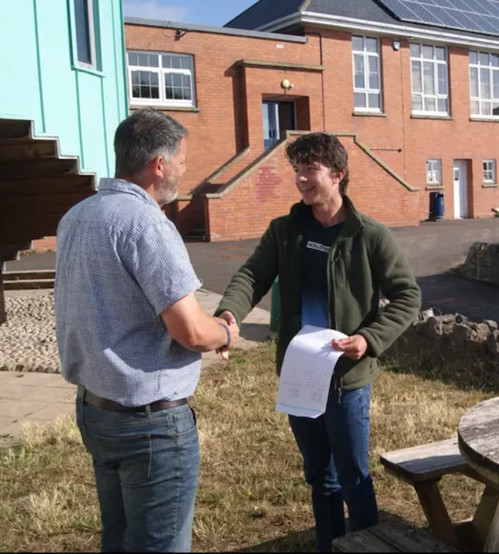
16-19 Bursary
What a bursary is for?
The 16-19 bursary is a limited fund made available for supporting eligible young people with the costs of transport, food, books, educational visits or other course materials or equipment essential to successfully completing their programme of study.
There is assistance available to support students at TCS6; application forms and more details are available from Mrs Deeks on completion of probation.

Slide 11
SF Phone Policy
Phones are permitted at the SFC and in lessons for educational reasons
Students should not have them visible around site.
Role model culture
Safeguarding implications

